Slide 1
Real-time audio descrambler
Using FPGA
Group 26
Individual contribution:
Yunong Chen (DAC & low pass filter)
Siyu Liu (ADC & digital filter)
Henry Sun (block diagram & research)
Nathan Yuen (signal multiplier, generating sine wave & DC bias circuit)

Slide 2
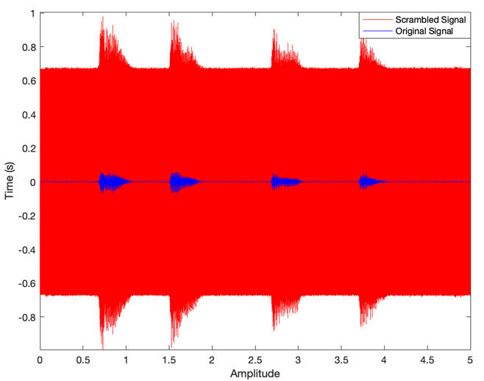
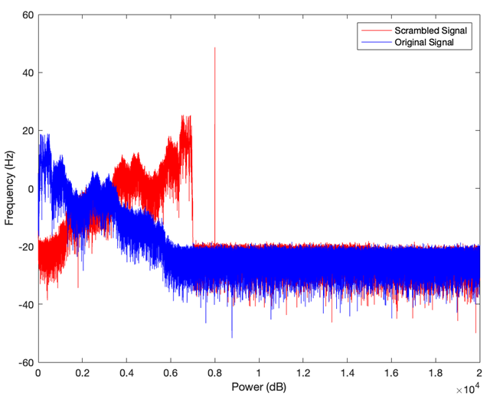
Original and Scrambled Signals
Using the scrambler provided, we are able to figure out how the message was scrambled. This two signals in the time domain has the same tempo, however the scrambled audio has a larger amplitude.
Using the fast Fourier transform function in MATLAB, we get the diagram in the frequency domain. The original signal has been flipped at 3.5kHz and there is also an extra tone at 8kHz added.
Notes:
A gang of criminals is working together with a computer expert to rob a van
The police has found a scrambled message relating to the crime, however, it does not make any sense
The goal of this project is to descramble the audio using an FPGA board

Slide 3
Introduction
8kHz Band-stop filter
Signal Multiplication with a 7kHz sine wave
ADC Process
Scrambled Message Input
Physical low-pass filter
DAC Process
Speaker playing Descrambled Message

Slide 4
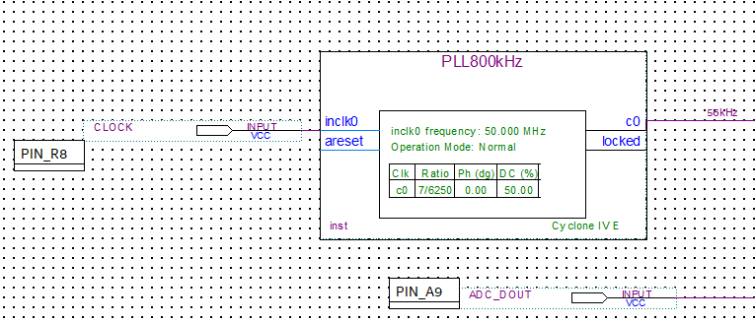
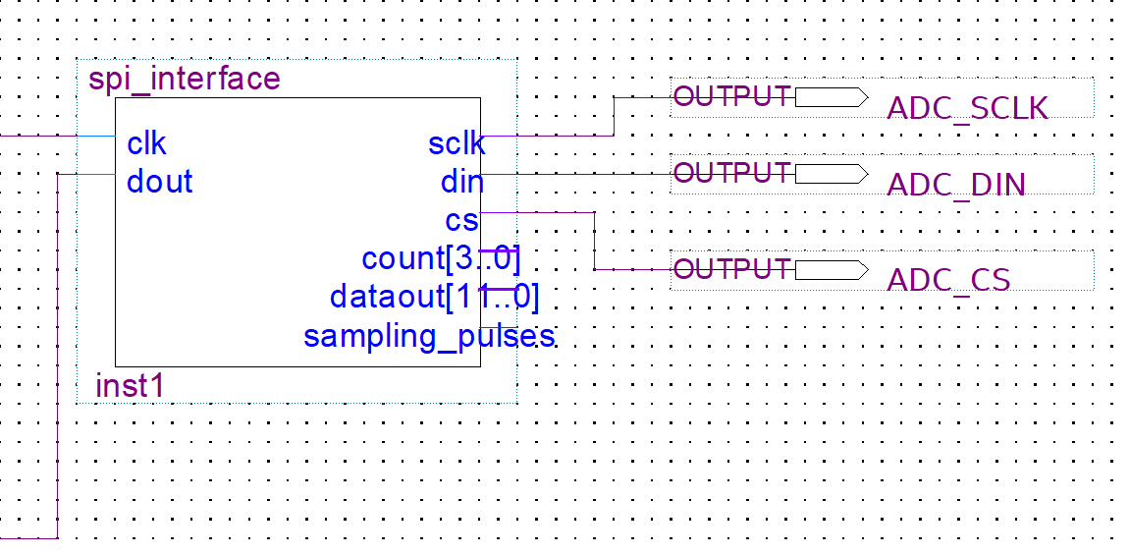
Clock Frequency and
Analog-to-Digital Converter (ADC)
It can convert the analog signal of the scrambled message into a 12-bit digital signal
Clock Frequency is provided the PLL Block and set to 56kHz as it will make it easier to design the sinusoidal wave for signal multiplication
Notes:
Phase-locked loop and Serial peripheral interface are two main parts of our analog-to-digital converter.
For the purpose of guaranteeing that the sampling clock of the ADC is in sync with the system clock, PLL is generally employed to provide an accurate clock signal. The PLL Block's clock frequency is set at 56 kHz since it will facilitate the construction of a sinusoidal wave for signal multiplication.
SPI is used to transfer the analog-to-digital converted data to other devices. Serial clock generates the clock signal is used for synchronous data transmission. Data in and out are input and output of the slave device. The ADC sends the converted digital signal to other devices via the DOUT pin.

Slide 5
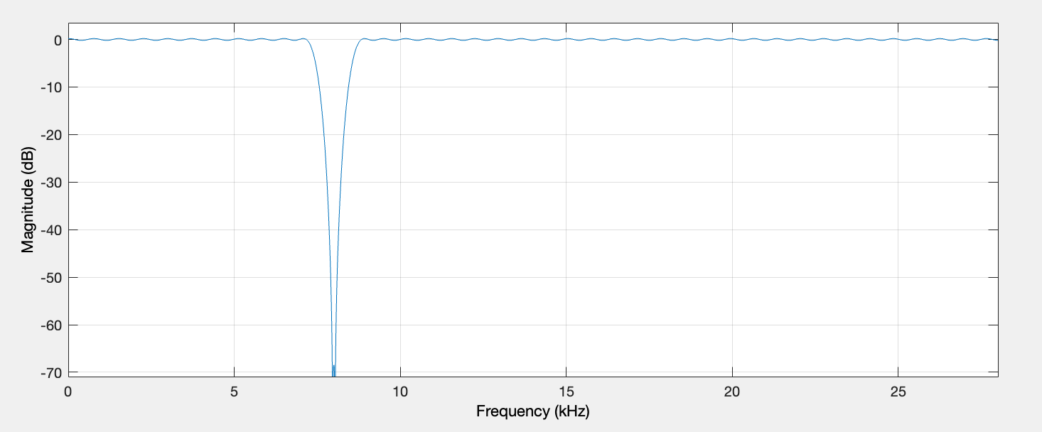
Digital Filter
By comparison with the Infinite Impulse Response (IIR) filter, the Finite Impulse Response (FIR) filter is more suitable for applications require linear phase response, such as audio signals, and is more stable with greater orders.
Equiripple method can produce higher energy concentration and avoid the distortion by ripple.
The filter is quantized into 12 bits and generate a Verilog code.
Signal Processing Toolbox Document, MATLAB, https://uk.mathworks.com/help/signal/ug/fir-filter-design.html
IIR Filters and FIR Filters, DIAdem Help, https://www.ni.com/docs/en-US/bundle/diadem/page/genmaths/genmaths/calc_filterfir_iir.htm
Filtering Basics: Importance of Linear Phase, J.Thai, 2022, https://info.erdosmiller.com/blog/filtering-basics-importance-of-linear-phase
Notes:
We used MATLAB to create a digital band-stop filter to eliminate the 8kHz tone while without affecting the remainder part of this signal. It has magnitude of xxdB with stop frequency from xxkHz to xxkHz, designed by equiripple finite impulse response and its sampling frequency is 56kHz.
Above all, there are two possibilities for design methods: infinite impulse response and finite impulse response. The output of IIR is dependent on the current input, past input, and output. And there is no past output for FIR. We can argue that FIR does not have feedback, or its output is not recursive.
An FIR filter is built since it is more suitable for audio signals. For starters, FIR can have a perfectly linear phase. The phase delay of IIR, on the other hand, may be modified by the input waveform. Furthermore, FIR is more stable than IIR. When we examined alternative ways for designing filters, we discovered that the minimal order for IIR is 2 and for FIR is around 200 to obtain a similar output. The negative is that the higher filter order may result in a great delay of DSP, but there is only one brief message to be descrambled.
At the same time, the equiripple we used often concentrate the main energy of the frequency response. This is beneficial for effectively filtering out unwanted frequency and it can avoid the signal distortion happens at the edge of the passband due to presence of a large ripple.
Then, the filter is quantized using fixed-point arithmetic, changing the input and output bits to 12 bits to match the ADC as it produces a 12-bit digital signal as well.
The last step is to convert the filter into verilog code and use the code to create symbol in our Quartus schematic.

Slide 6
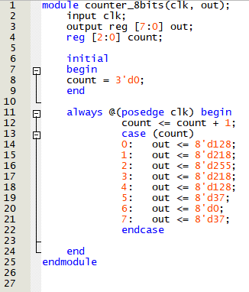
Generating Sinusoidal Wave
56kHz Sampling Frequency means that the
7kHz sine wave is sampled 8 times in one oscillation
Wave is sampled on every positive edge of the clock
The sinusoidal wave can be observed on the signal tap logic analyser

Slide 7
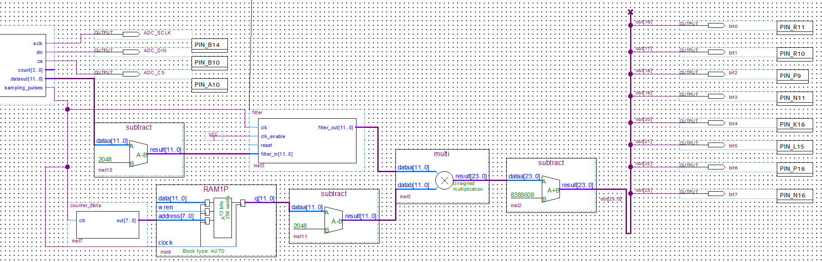
Signal Multiplier
The ADC outputs unsigned binary while the digital filter produces in filter designer in MATLAB uses 2's Compliment
The output of the filter is multiplied with the generated sinusoidal wave
The eight most significant bits are output to the DAC circuit

Slide 8
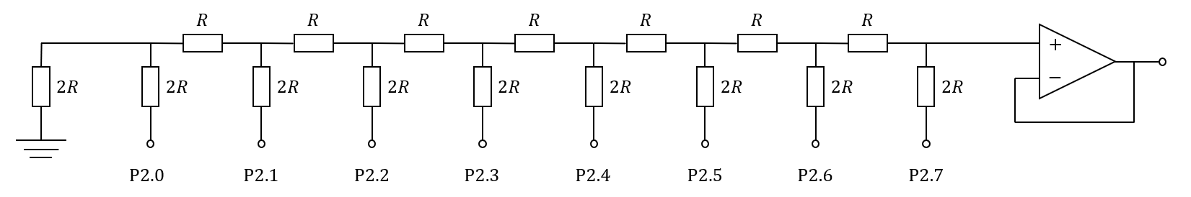
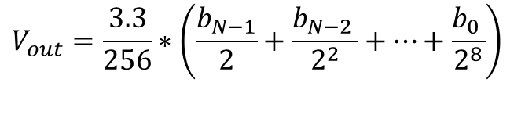
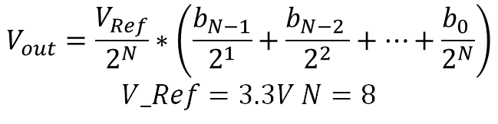
R-2R Digital Analog Converter (DAC)
OUTPUT
R = 500Ω with 5V DC input
$$V_{out}=\frac{V_{Ref}}{2^{N}}∗\left(\frac{b_{N−1}}{2^{1}}+\frac{b_{N−2 }}{2^{2}}+…+\frac{b_{0 }}{2^{N}}\right)$$
$$V_Ref=3.3V N=8$$
$$V_{out}=\frac{3.3}{256}∗\left(\frac{b_{N−1}}{2}+\frac{b_{N−2 }}{2^{2}}+…+\frac{b_{0 }}{2^{8}}\right)$$
Overall configuration
DAC consists of 8-bit R-2R Resistive Ladder Network and a voltage follower
Ladder configuration
R-2R can be easily scaled to the desired number of bits and only requires two resistors
Mismatching and noise issues
Voltage follower
Voltage follower configuration is safer than the inverting amplifier configuration
https://www.electronics-tutorials.ws/combination/r-2r-dac.html
S. S. Parmar and A. P. Gharge, "R-2R ladder circuit design for 32-bit digital-to-analog converter (DAC) with noise analysis and performance parameters," 2016 International Conference on Communication and Signal Processing (ICCSP), Melmaruvathur, India, 2016, pp. 0467-0471, doi: 10.1109/ICCSP.2016.7754180.
Notes:
Ladder configuration
If the input bit is 0, use 500ohm, 1, using 1k ohm
8 bit, 256 = 2^8 cases,
Every input have Thevenin’s resistor of 2R
Advantage:
Simpler than other DAC such as…, N input only need 2N resistors(cheap)
Disadvantage:
Mismatch issue: since many resistors, mismatching can cause noise and current biasing
Noise: Switching Transients: When switches are are switched on or off, transient currents and voltages may be generated, leading to transient noise. In time domain
Voltage follower:
improves signal integrity and stability
In specific: R-2R DACs typically have a relatively high output impedance. voltage follower provides a low output impedance
minimizes signal distortion and ensures effective impedance matching with subsequent low pass filter

Slide 9
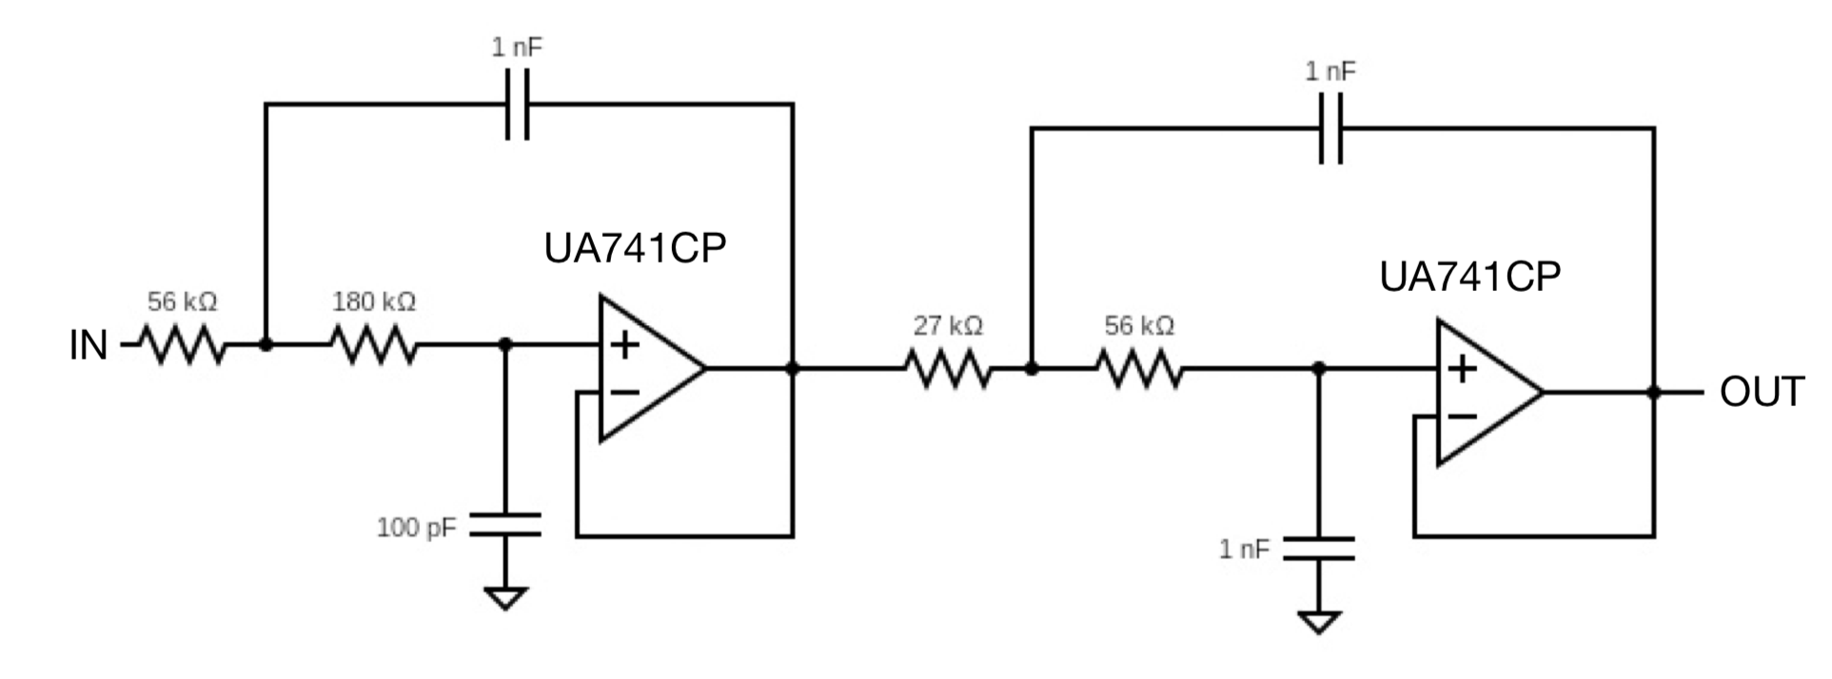
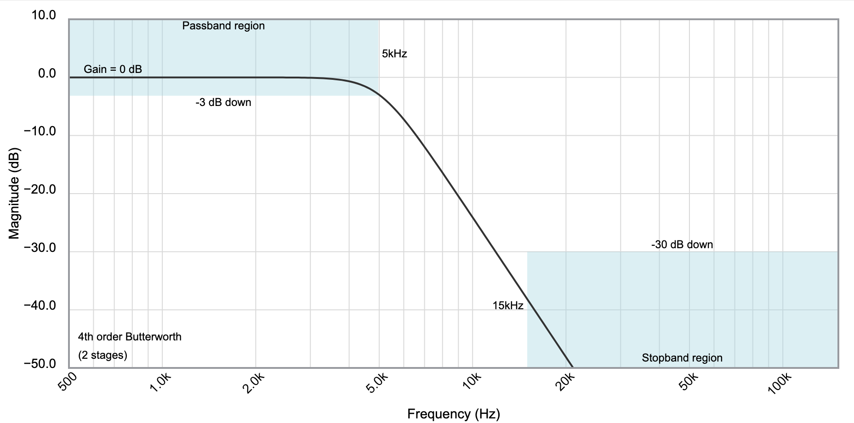
Low-pass Filter
Filter Analog Wizard is used to design the filter with cutoff frequency at 5kHz
Used as an anti-aliasing filter
Analog Filter Wizard, Filter Design Tool | Filter Wizard | Analog Devices
Notes:
Reason of choosing the gain and stop band
Use the filter design tool to design the lowpass filter
Aliasing occurs if a signal contains frequencies higher than the Nyquist frequency and is not properly filtered before sampling
these high-frequency components fold back into the sampled signal, causing distortion and inaccuracies
So the stopband is chosen based on the sampling frequency, just below It
Since a new upper band signal will occur when, and this lowpass filter is aiming to filtering out this.

Slide 10
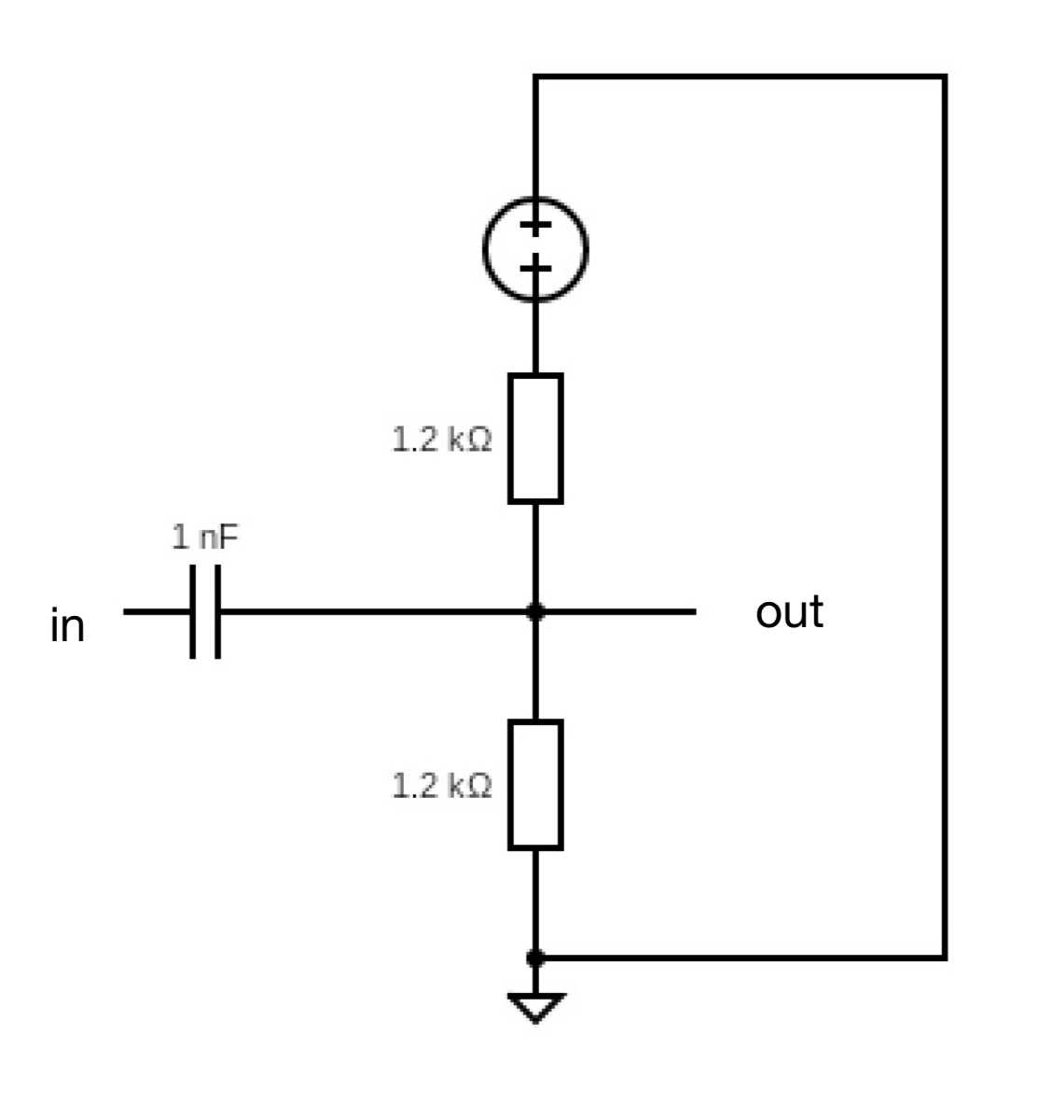
DC Biasing
The DC bias circuit increases the signal to a point above 0 and centered at 1.65V.

Slide 11
END
Group 26
15.12.2023

